Slide 1
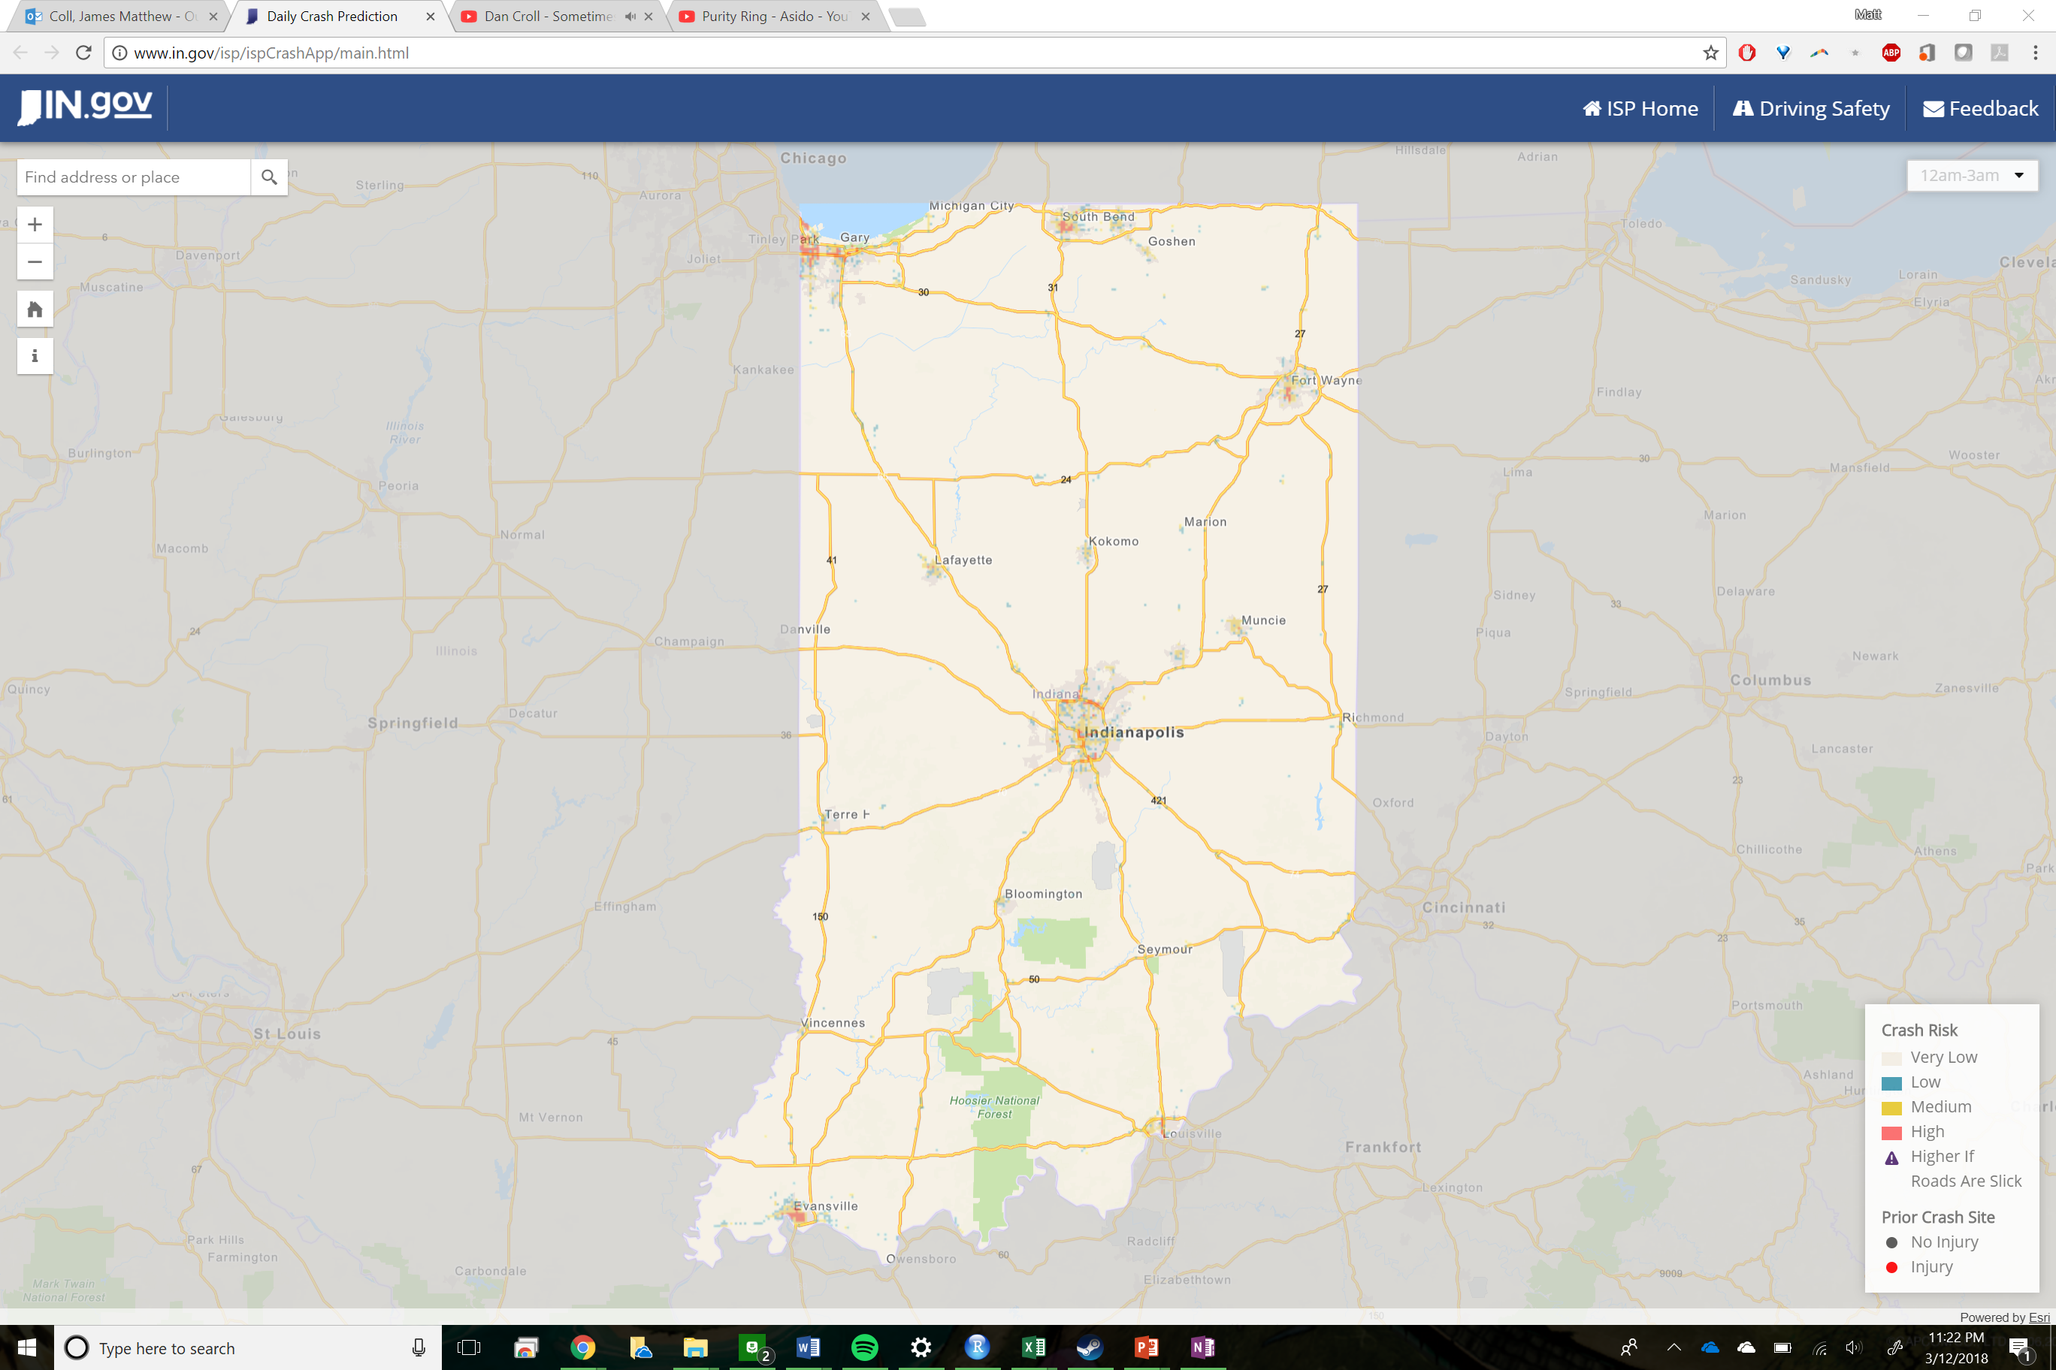

Slide 2
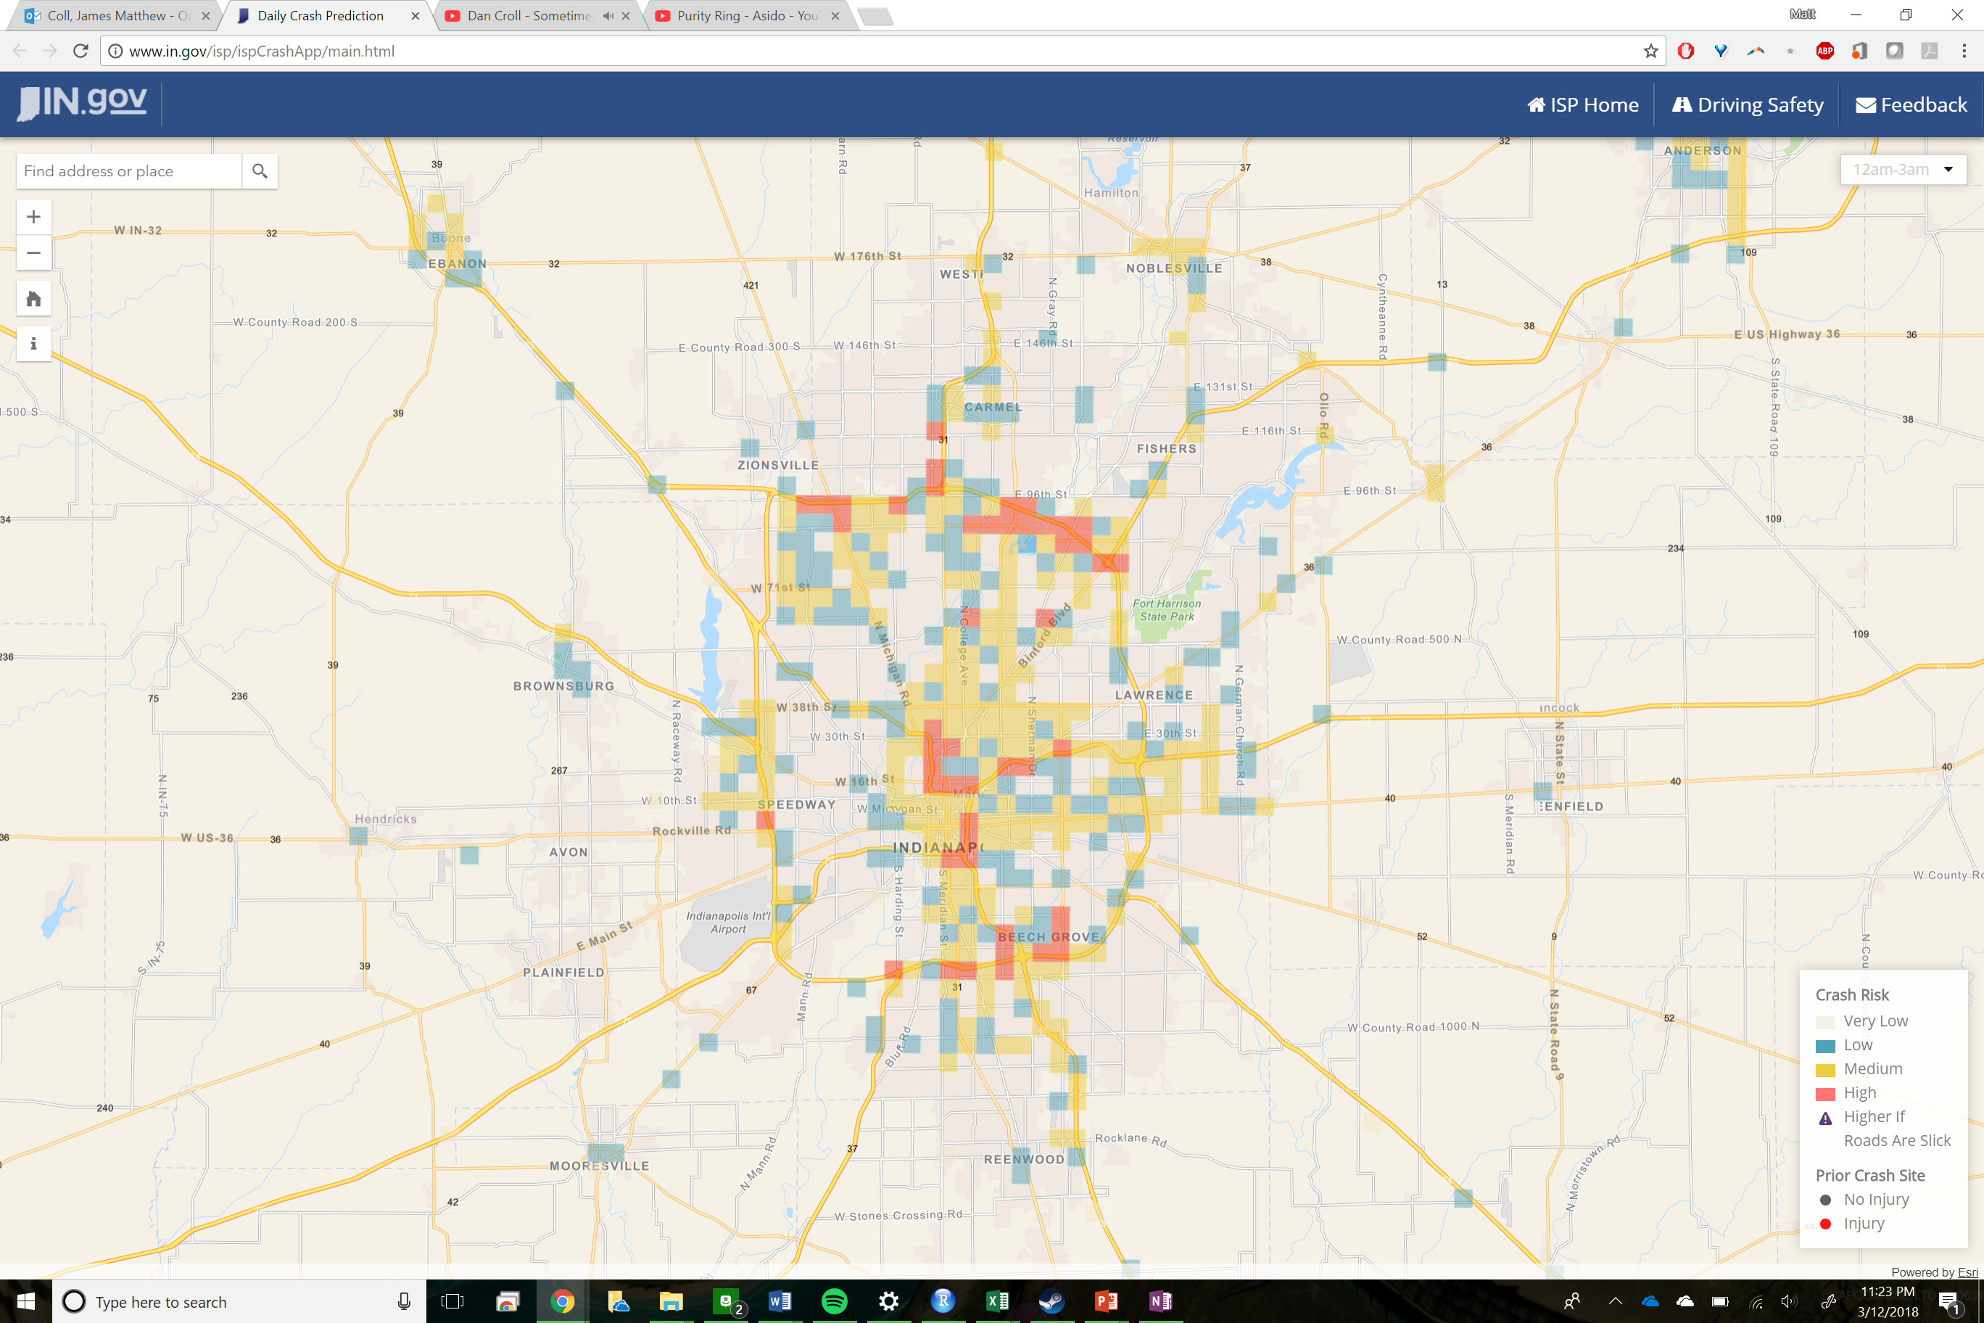

Slide 3
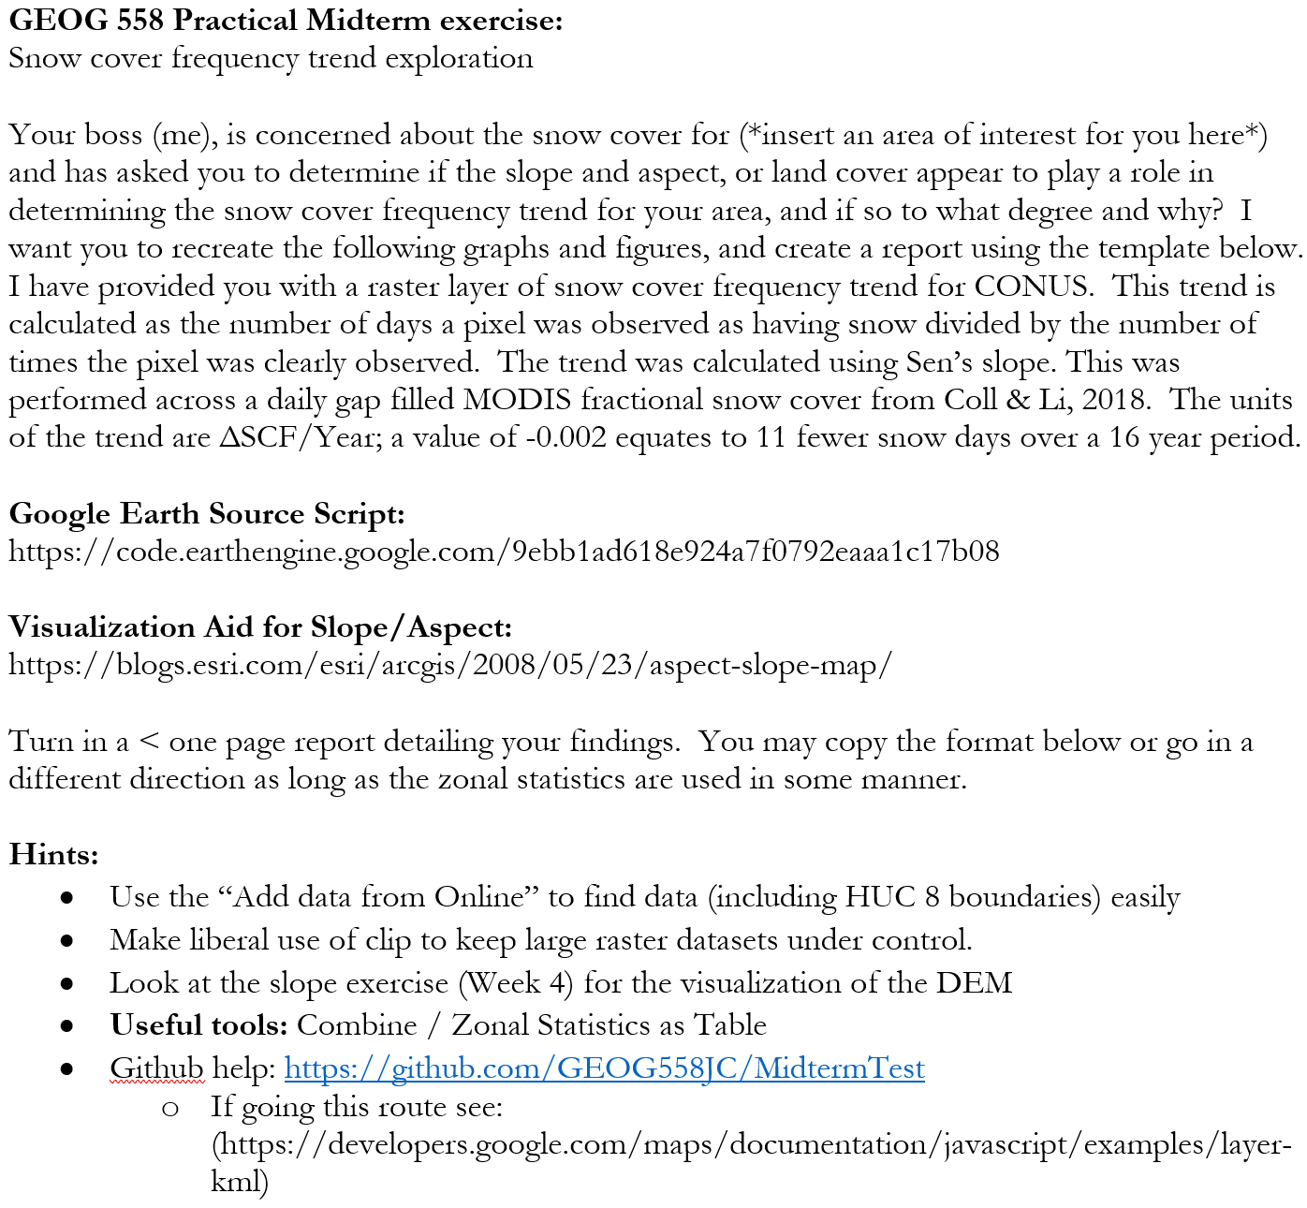

Slide 4
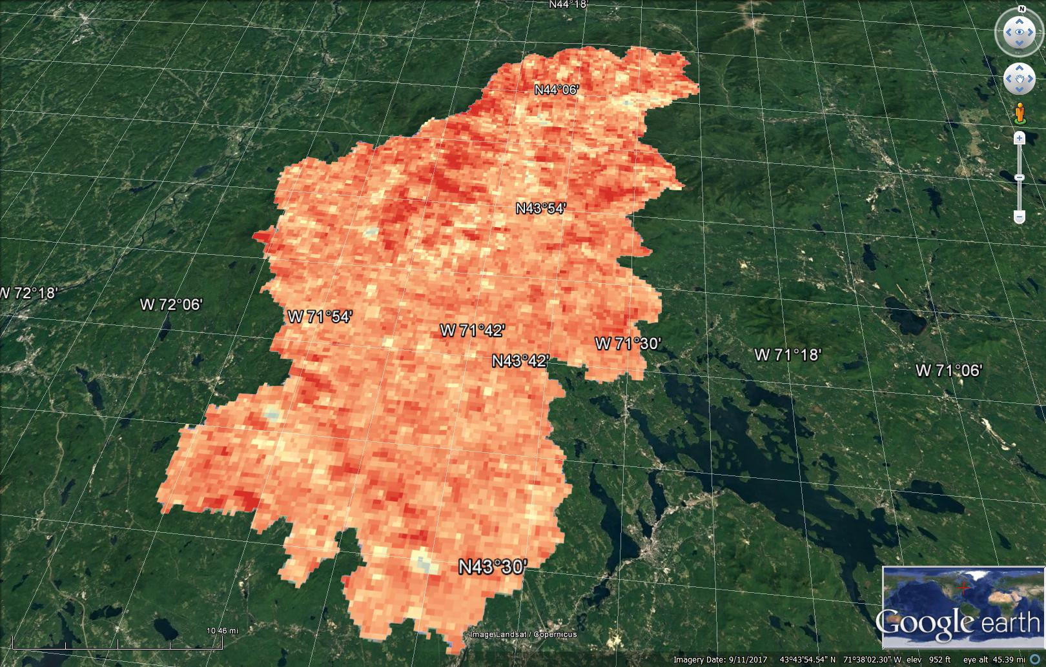

Slide 5
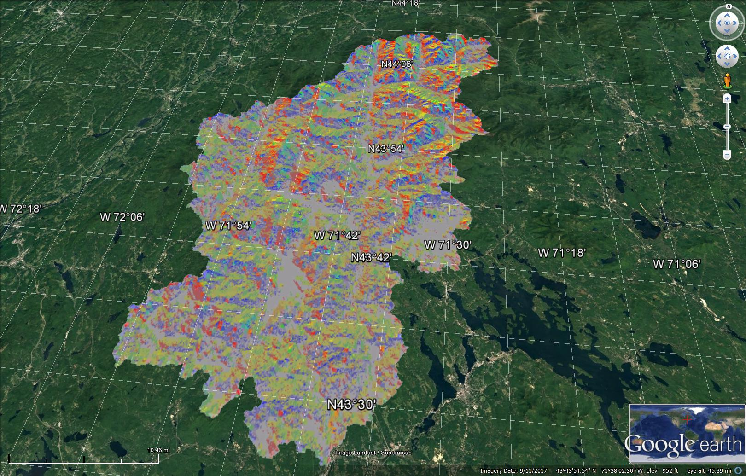

Slide 6
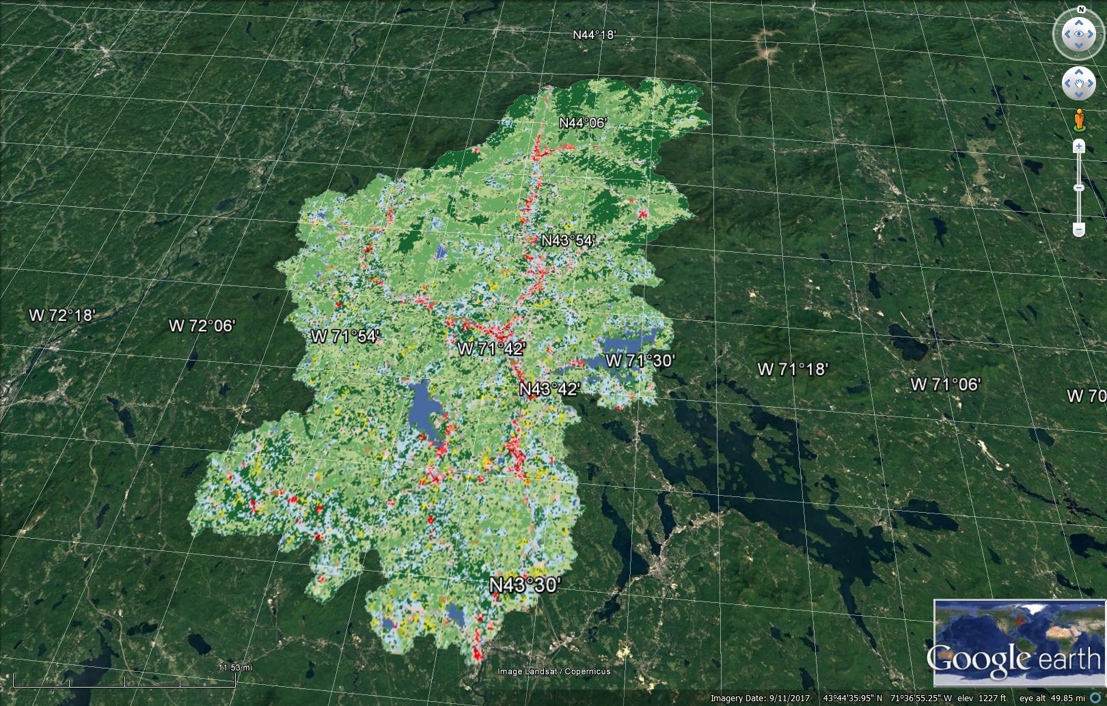

Slide 7
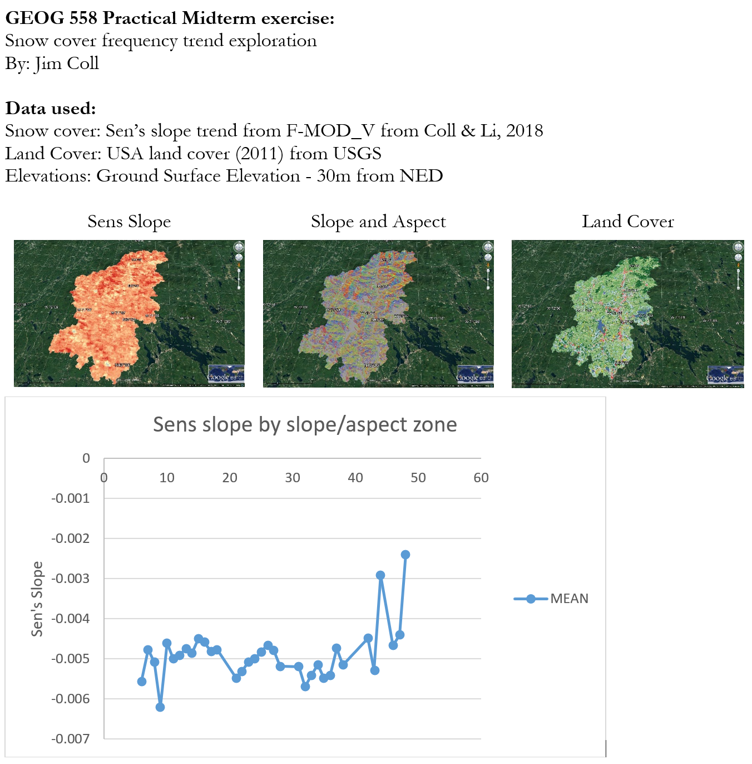
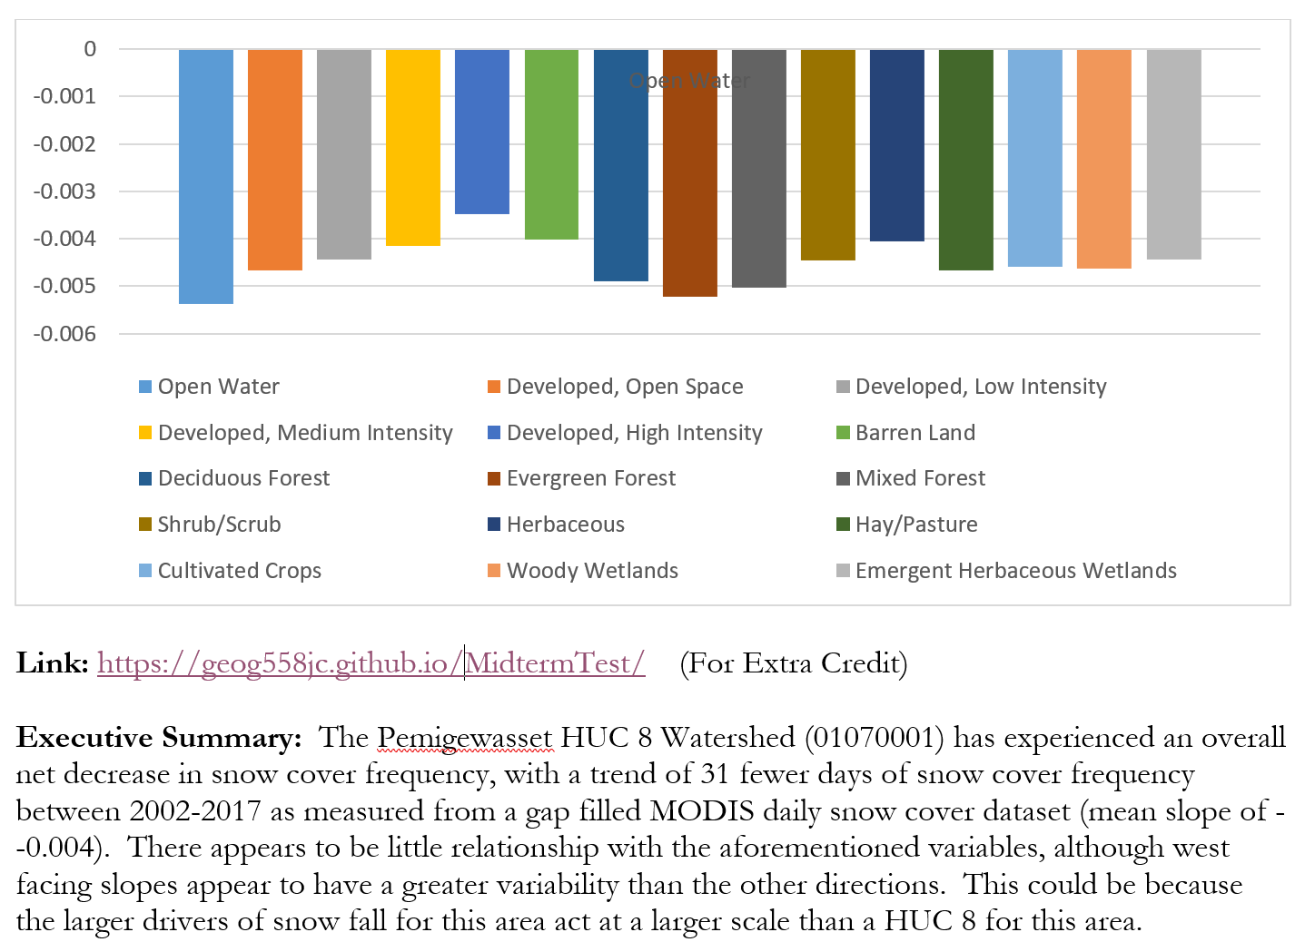
Snow Cover Frequency
Ranking Locations for a certain purpose
Examine alternatives in an objective ways

Slide 8
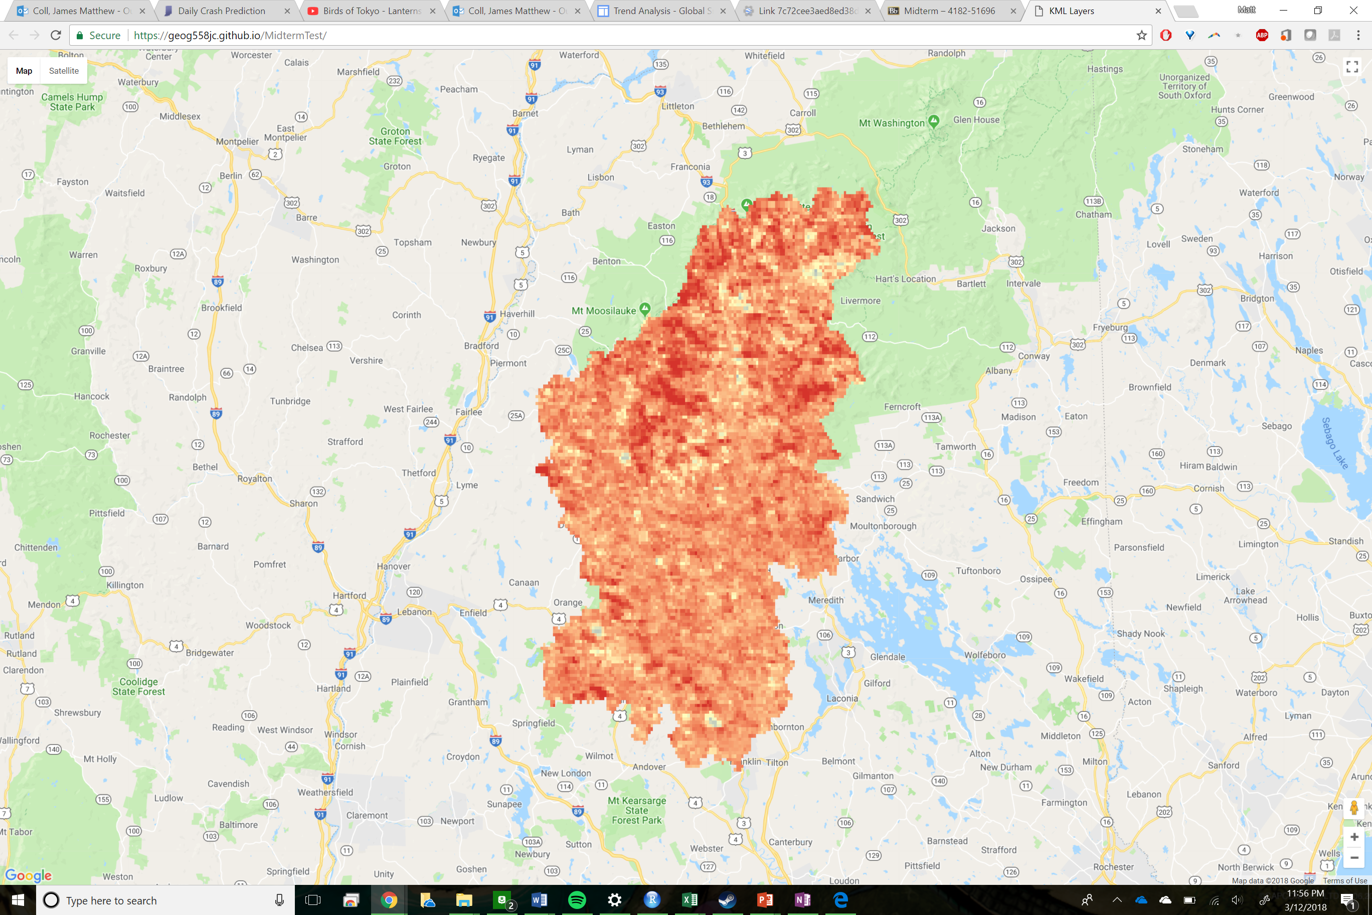
Snow Cover Frequency
Ranking Locations for a certain purpose
Examine alternatives in an objective ways

Slide 9
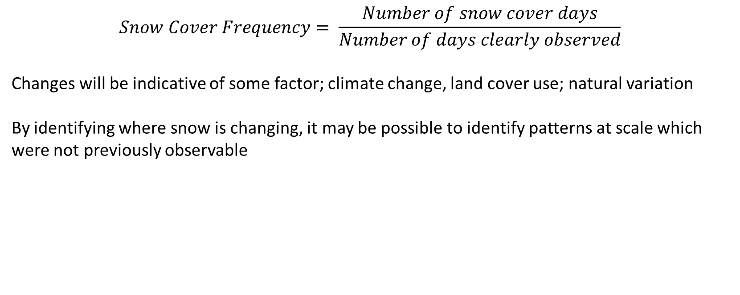
Snow Cover Frequency
$$Snow Cover Frequency= \frac{Number of snow cover days}{Number of days clearly observed}$$
Changes will be indicative of some factor; climate change, land cover use; natural variation
By identifying where snow is changing, it may be possible to identify patterns at scale which were not previously observable

Slide 10
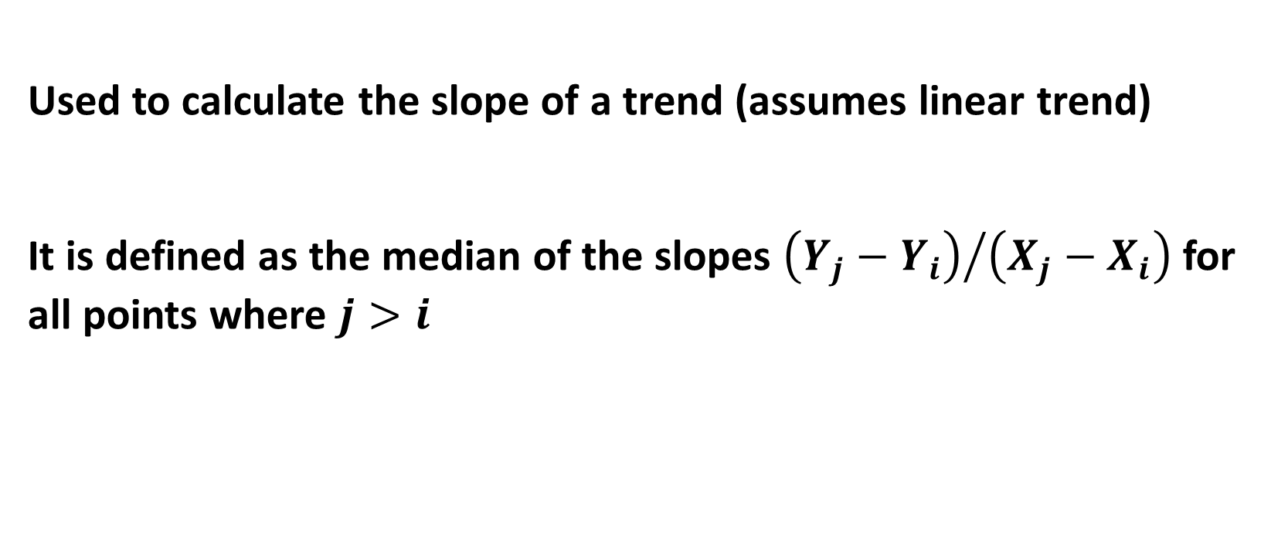
Sen’s slope
OUTLINE
Why Snow?
Past Work
About the MODIS Platform
Using MODIS Snow Data
Accuracy Assessment
Means
Metrics
Accuracy Results
Fractional Band and SWE
Temporal Variation
Year
Month
Geographic Factors
Latitude
Elevation
Land Cover
Sensor Factors
Mixed Pixel
Sensor Zenith
Solar Zenith
Site Specific
Gap Filling Methods
Accuracy Conclusions
Trend Assessment
Statistics
Validation
Trend Maps
Potential Uses & Impact
Global Snow Observatory
Q&A
Used to calculate the slope of a trend (assumes linear trend)
It is defined as the median of the slopes ${\left(Y_{j}−Y_{i}\right)}/{\left(X_{j}−X_{i}\right)}$ for all points where $j>i$

Slide 11
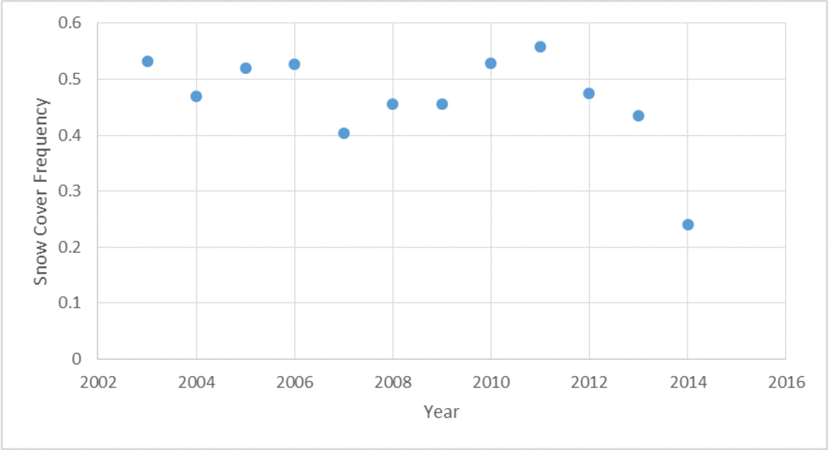
OUTLINE
Why Snow?
Past Work
About the MODIS Platform
Using MODIS Snow Data
Accuracy Assessment
Means
Metrics
Accuracy Results
Fractional Band and SWE
Temporal Variation
Year
Month
Geographic Factors
Latitude
Elevation
Land Cover
Sensor Factors
Mixed Pixel
Sensor Zenith
Solar Zenith
Site Specific
Gap Filling Methods
Accuracy Conclusions
Trend Assessment
Statistics
Validation
Trend Maps
Potential Uses & Impact
Global Snow Observatory
Q&A
Sen’s slope

Slide 12
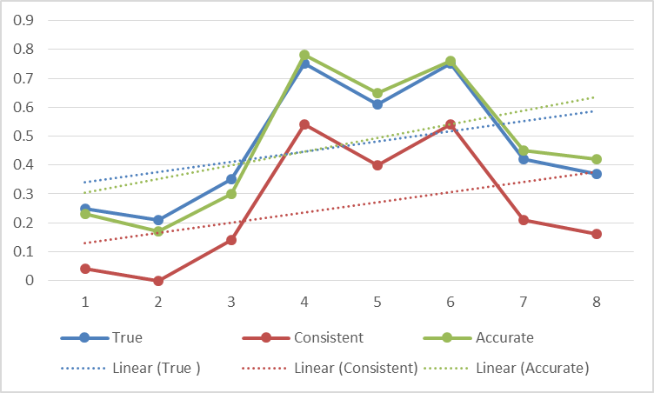
Trend Validation
OUTLINE
Why Snow?
Past Work
About the MODIS Platform
Using MODIS Snow Data
Accuracy Assessment
Means
Metrics
Accuracy Results
Fractional Band and SWE
Temporal Variation
Year
Month
Geographic Factors
Latitude
Elevation
Land Cover
Sensor Factors
Mixed Pixel
Sensor Zenith
Solar Zenith
Site Specific
Gap Filling Methods
Accuracy Conclusions
Trend Assessment
Statistics
Validation
Trend Maps
Potential Uses & Impact
Global Snow Observatory
Q&A
For a trend analysis, it is more desirable for the dataset to be consistent first, and accurate second.
In this case, consistency is approximated by the R2 value, and accuracy in the slope. The closer to 1 the slope approaches, the higher the accuracy.

Slide 13
Trend Validation
OUTLINE
Why Snow?
Past Work
About the MODIS Platform
Using MODIS Snow Data
Accuracy Assessment
Means
Metrics
Accuracy Results
Fractional Band and SWE
Temporal Variation
Year
Month
Geographic Factors
Latitude
Elevation
Land Cover
Sensor Factors
Mixed Pixel
Sensor Zenith
Solar Zenith
Site Specific
Gap Filling Methods
Accuracy Conclusions
Trend Assessment
Statistics
Validation
Trend Maps
Potential Uses & Impact
Global Snow Observatory
Q&A

Slide 14
Trend Validation
OUTLINE
Why Snow?
Past Work
About the MODIS Platform
Using MODIS Snow Data
Accuracy Assessment
Means
Metrics
Accuracy Results
Fractional Band and SWE
Temporal Variation
Year
Month
Geographic Factors
Latitude
Elevation
Land Cover
Sensor Factors
Mixed Pixel
Sensor Zenith
Solar Zenith
Site Specific
Gap Filling Methods
Accuracy Conclusions
Trend Assessment
Statistics
Validation
Trend Maps
Potential Uses & Impact
Global Snow Observatory
Q&A

Slide 15
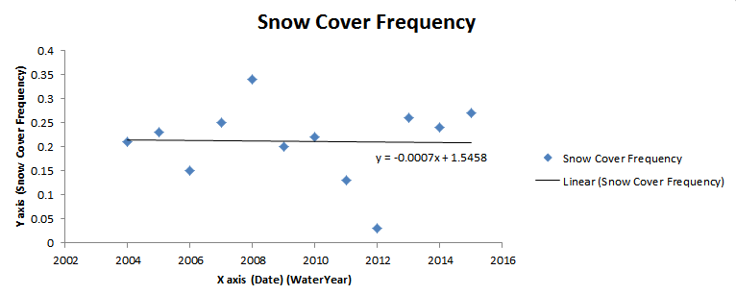
Snow Cover Frequency trend

Slide 16
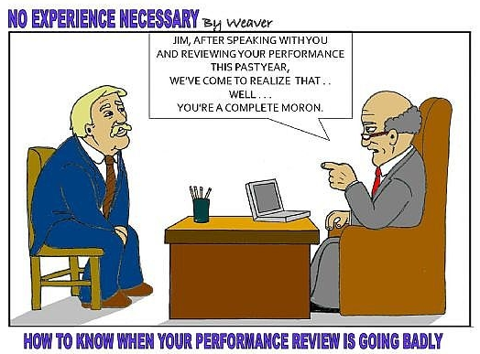

Review!

